Slide 1
Sample Data Tracking (SDT)
.NET Application by Beth Williams
Project Goals:
Create a .NET Application that makes relating/navigating all the SDT Data in Oracle (schemas, tables, column names) and SharePoint (DDS) searchable and accessible to the general user.
Make Application independent of Toad/Oracle and SharePoint access; a consolidated “one-stop” location for learning, searching, and navigating SDT Data structure.

Slide 2
SDT: The DATA
TOAD Database (Oracle)
Commonly Used Schemas = 5
Tables = 2, 281
Column Names = 1,143
SharePoint
SDT Design Description (DDS) = 518 pages

Slide 3
SDT: Getting the Data into .NET
Excel/Toad
First Approach: Export Toad into excel (created separate excel files for each table)
  Too time consuming to open a separate excel file per table per schema and copy/paste.
  Could not export entire schema due to size of Data. Had to export each table individually.
Second Approach: Copy/Paste directly from Toad into Excel (tedious but worked)
  Approx. 1 hour per Schema (5 hours total)
  4,910 Excel Rows
  567 KB Excel File Size
Import Excel (.xls or .xlsx) into C# using “Provider=Microsoft.Jet.OLEDB.4.0”.
  Install http://www.microsoft.com/download/en/confirmation.aspx?id=23734
  Add using directive “using System.Data” & “using System.Data.OleDb”.
  Format Excel cells from “General” to Text” format.
  Add reference by right clicking Project, COM\Libraries\Microsoft Office 16.0 Objet Library.

Slide 4
ImportExcelXLS C# Code
public static DataSet ImportExcelXLS(string FileName, bool hasHeaders)
{
string HDR = hasHeaders ? "Yes" : "No";
string strConn = "Provider=Microsoft.Jet.OLEDB.4.0;Data Source=" + FileName + ";Extended Properties=\"Excel 8.0;HDR=" + HDR + ";IMEX=1\"";
DataSet output = new DataSet();
using (OleDbConnection conn = new OleDbConnection(strConn))
{
conn.Open();
DataTable dt = conn.GetOleDbSchemaTable(OleDbSchemaGuid.Tables, new object[] { null, null, null, "TABLE" });
foreach (DataRow row in dt.Rows)
{
string sheet = row["TABLE_NAME"].ToString();
OleDbCommand cmd = new OleDbCommand("SELECT * FROM [" + sheet + "]", conn); // This query can be tailored to users needs.
cmd.CommandType = CommandType.Text;
DataTable outputTable = new DataTable(sheet);
output.Tables.Add(outputTable);
new OleDbDataAdapter(cmd).Fill(outputTable);
}
}
return output;
}

Slide 5
Question: Organization(comboBox(dropdown), dataGridViews, buttons, text box, etc.)?
Probem: .NET only allows 100 items in a dropdown list
Solution: Divide column names into their alphabetical index.

Slide 6
Second Solution: Create a second index (first 2 alphabet characters of each column name).
S
R

Slide 7
SDT: Getting the DDS into .NET
DDS is a Word .docx file
In Visual Studio, Add reference by right clicking on project/solution.
Under COM\Type Libraries, Check “Microsoft Word 16.0 Object Library” (VS 2015 community)
Use a Rich Text Box in .NET to display imported Word document (read only).
Add using directive “using Word = Microsoft.Office.Interop.Word”
Use .NET button and click event to handle the import of the DDS.

Slide 8
Import DDS (.docx) C# Code
private void getDDS_click(object sender, EventArgs e)
{
Microsoft.Office.Interop.Word.Application wordObject = new Microsoft.Office.Interop.Word.Application();
object File = "c:\\SDT\\SDT_DDS.docx"; //this is the path
object nullobject = System.Reflection.Missing.Value;
Microsoft.Office.Interop.Word.Application wordobject = new Microsoft.Office.Interop.Word.Application();
wordobject.DisplayAlerts = Microsoft.Office.Interop.Word.WdAlertLevel.wdAlertsNone; Microsoft.Office.Interop.Word._Document docs = wordObject.Documents.Open(ref File, ref nullobject, ref nullobject, ref nullobject, ref nullobject, ref nullobject, ref nullobject, ref nullobject, ref nullobject, ref nullobject, ref nullobject, ref nullobject, ref nullobject, ref nullobject, ref nullobject, ref nullobject); docs.ActiveWindow.Selection.WholeStory();
docs.ActiveWindow.Selection.Copy();
this.rtb.Paste();
docs.Close(ref nullobject, ref nullobject, ref nullobject);
wordobject.Quit(ref nullobject, ref nullobject, ref nullobject);
}

Slide 9
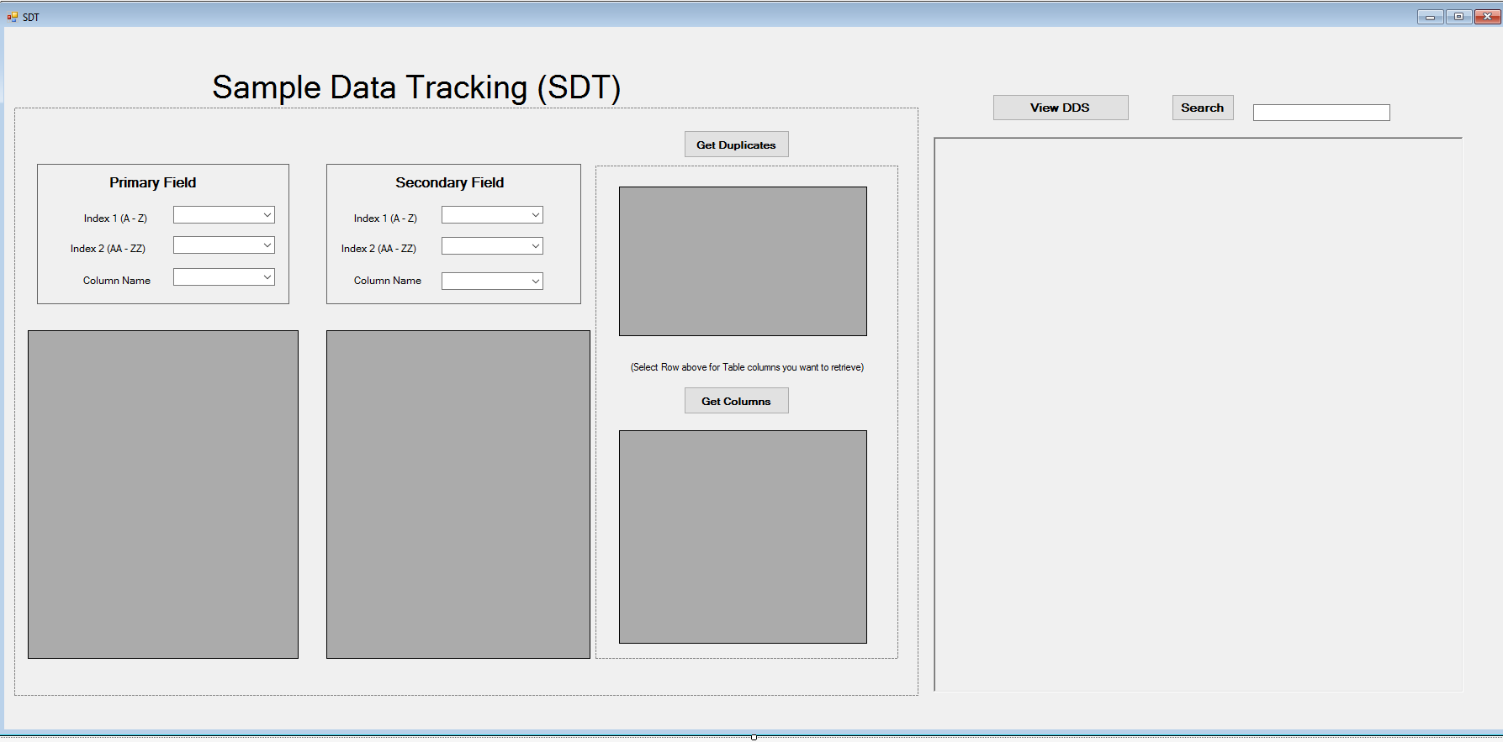
Resulting .NET Application

Slide 10
SDT .NET App: How it Works?
.Net Widgets:
  6 comboBox (index1 (x2), index2 (x2), Column Name (x2)
  4 dataGrid Views (Primary/Secondary Field table display, Duplicates display, Columns display)
  4 Buttons (Get Duplicates, Get Columns, View DDS, Search)
  1 Rich Text Box
  1 Text Box
Primary(P)/Secondary(S) Fields: Allows user to select column names of interest, and compare possible relations.
P/S dataGridViews: Displays tables that contain the column name selected.
Get Duplicates: Displays common tables between P & S fields in a new dataGridView.
Get Columns: Based on selected row in duplicates dataGridView, displays all columns in that given table in a new dataGrid View.
View DDS: Imports SDT Design Description into Rich Text box.
Search: Based on users text input, highlights all instances of that search criteria.

Slide 11
Maintenance: Going Forward…
Periodically will need to retrieve most recent version of DDS on SharePoint.
If Tables or Column Names are updated in TOAD, will need to update Excel file accordingly to keep data current.
  How will I know? Ideally administrator would communicate updates/changes.
  Quarterly check?
  Is their a more efficient way to export data from Toad (queries, etc?)

